Slide 1
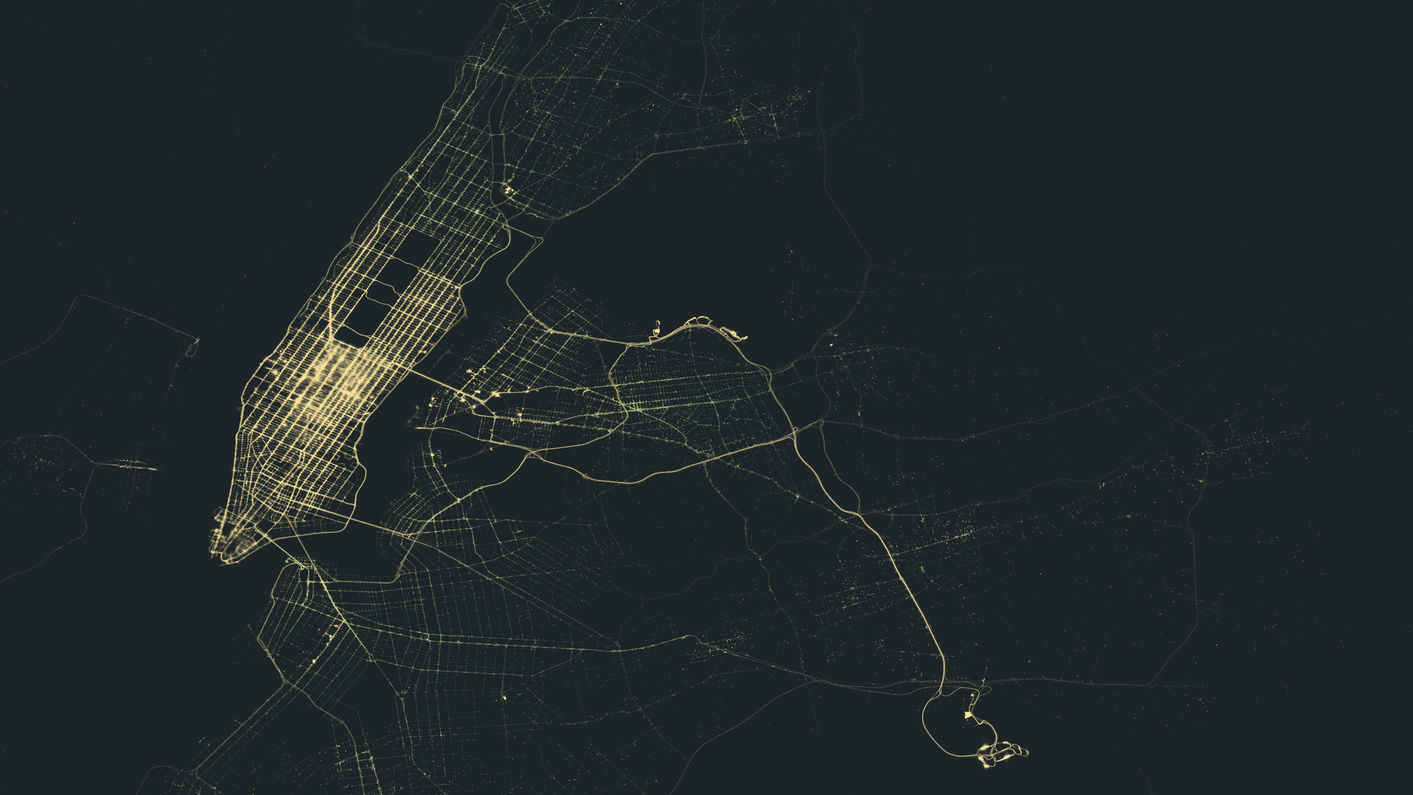
Context Analysis of Taxi Data Using the Powerwall
Applications for powerwall and virtual reality environments
Group 3 – Julia Klein, Julius Rauscher
11.02.2020

Slide 2
Motivation
Powerwall offers large visualization space
Highlight abnormalities in large datasets
Make outliers & relationships visible
→ Visualize geospatial data on the Powerwall

Slide 3
Data
2016 New York Taxi Trip Data
131.165.043 data rows
Longitude, longitude, date & time for pickups and drop-offs
Passenger count, trip distance, fare amount
Data Preprocessing
~4.5 million data rows for April → sampled ~100.000
Filtering of unreasonable data values
Timestamps
Longitude / latitude
Trip duration

Slide 4
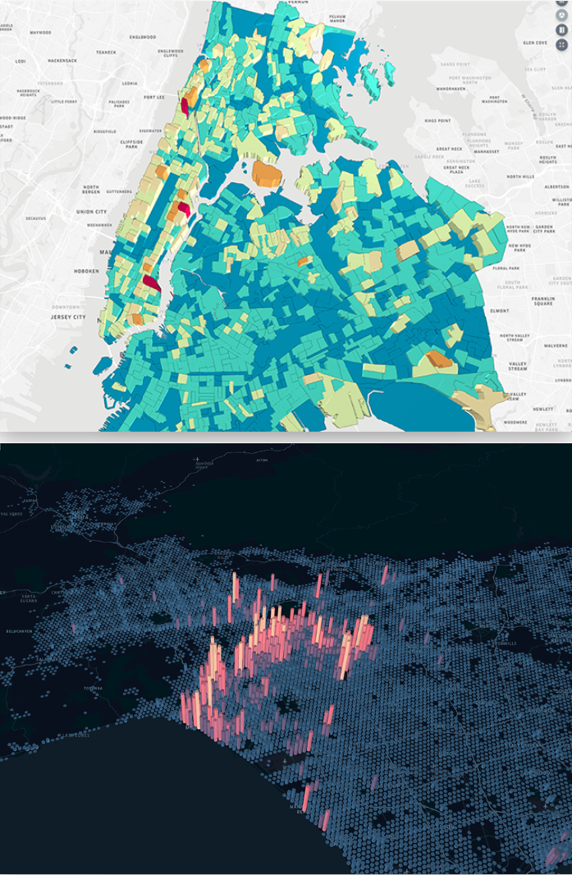
Kepler.gl
“A customizable geospatial toolbox to help make data-driven decisions.”
Created by Uber
Open Source JavaScript
Mapbox GL
React & Redux
https://kepler.gl/

Slide 5
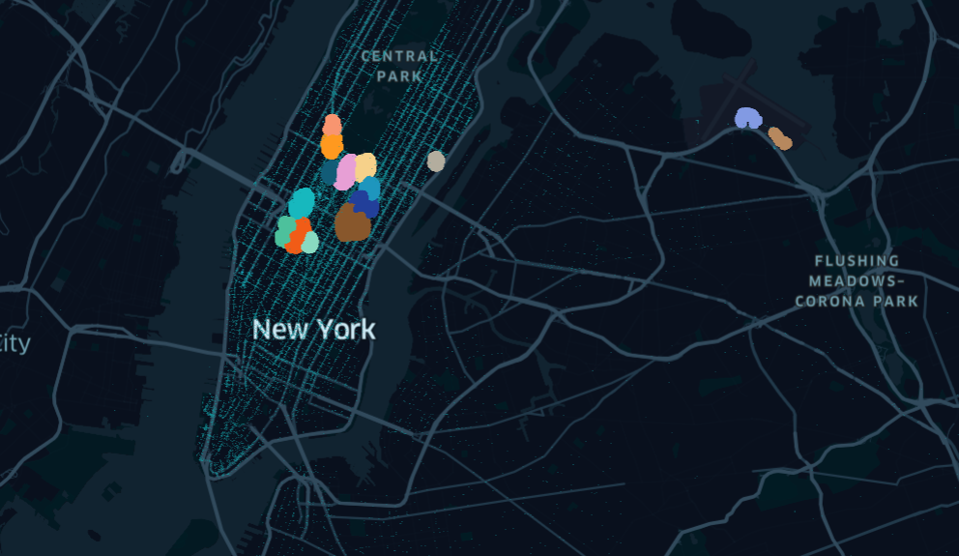
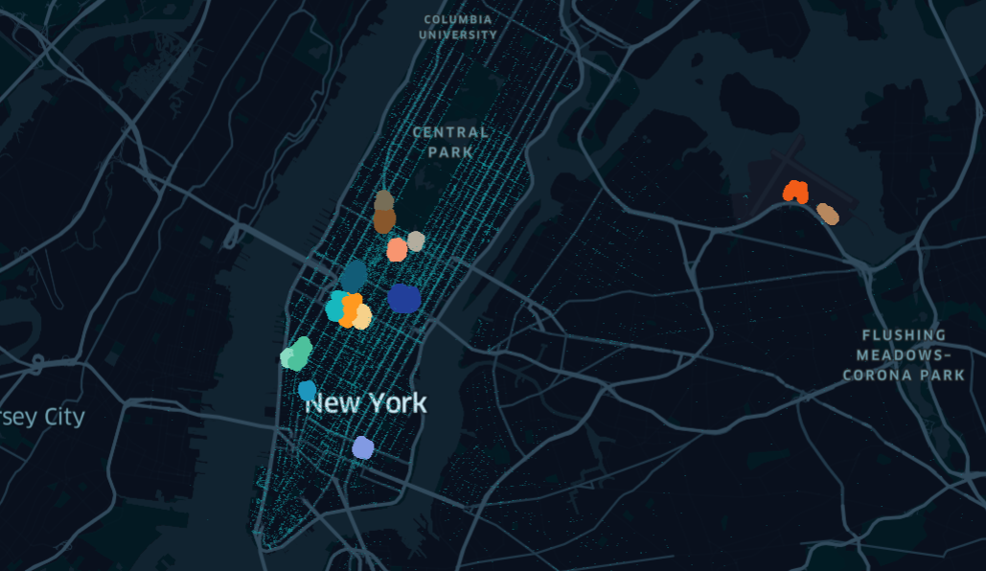
Clustering
DB Scan of all locations
Colors indicate cluster
Separate clustering for weekdays & weekend
Automatic jumping to cluster when selected
Show lines where people come from

Slide 6
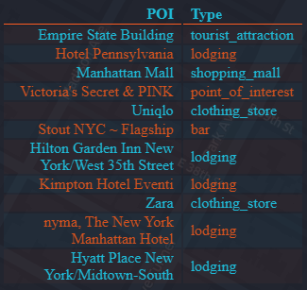
Points of Interest
Identify frequented places around cluster center
Justify clustering
Use API to gather additional information on each cluster
Foursquare
Yelp
Biased toward restaurants
Google Maps Places API
Query limit

Slide 7
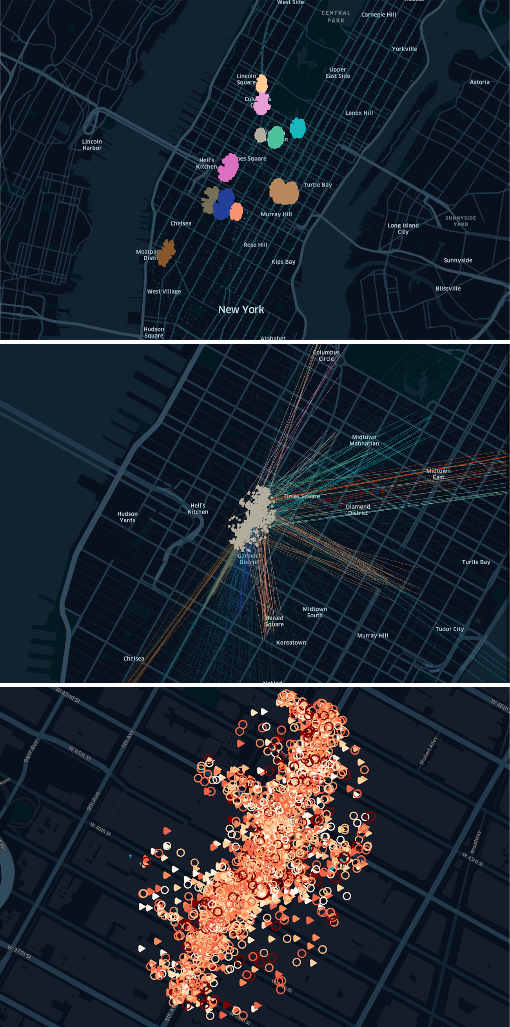
Semantic Zoom
Different levels of granularity
Overview
Cluster connections
Individual cluster
Size of points depends on zoom level

Slide 8
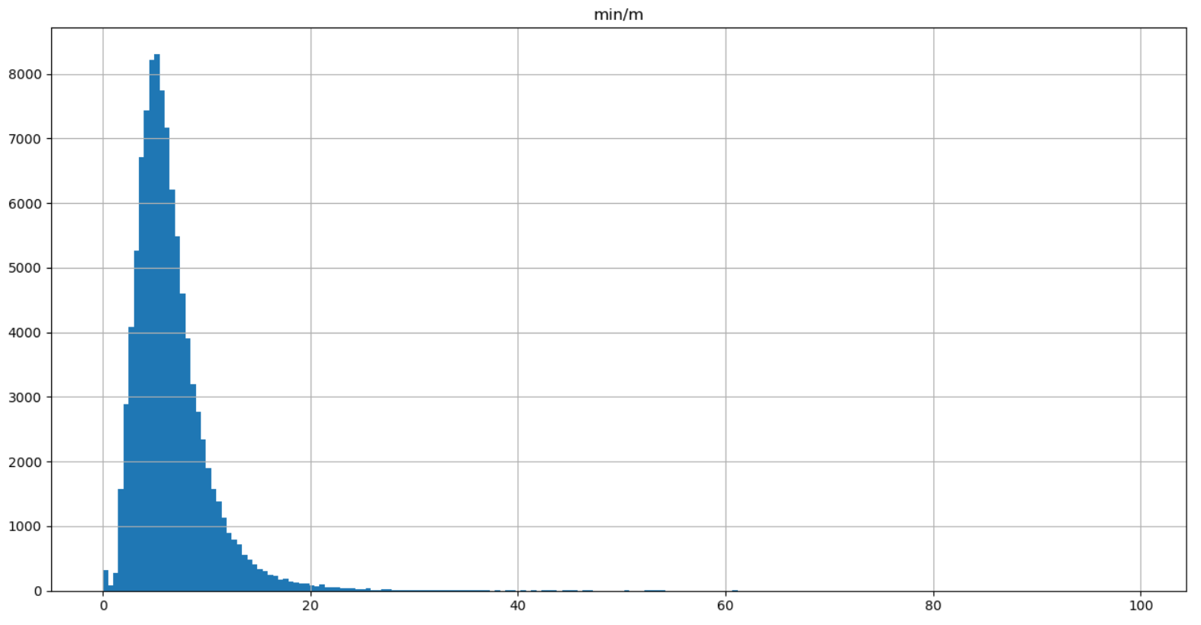
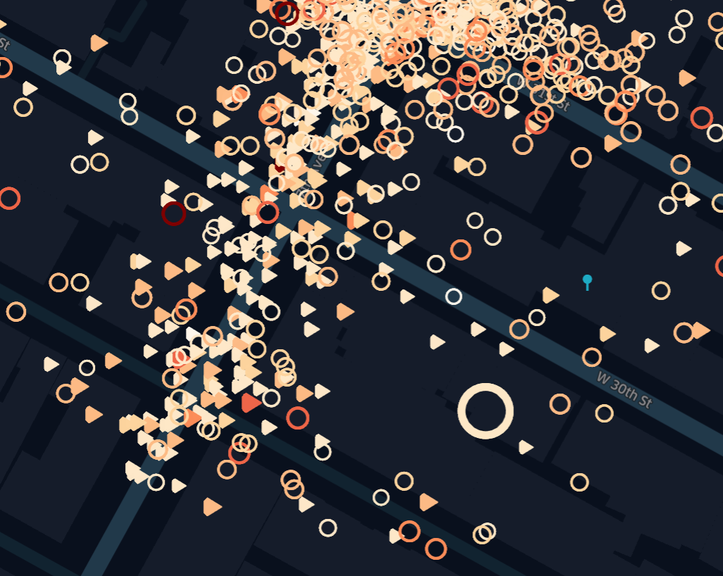
Semantic Zoom
Change visualization when zoomed in
Shape: pickup / drop-off
Color: relation of trip duration to trip distance
Equal-width binning for 0-20 min/m
All >20 are in highest bin
Size: relation of fare amount to trip distance

Slide 9
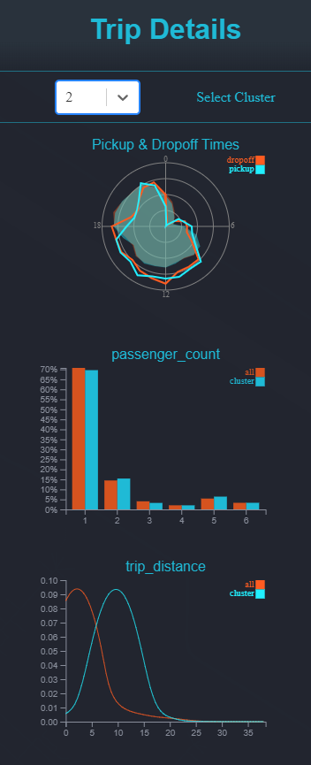
Trip Details
Summary of data
Overview over individual attributes
Visualizes distribution of data
Applicable to entire dataset and single clusters
See cluster’s characteristics in relation to all data points

Slide 10
Limitations
Limited amount of data points can be pre-loaded
Only size and color of data points are changeable
Use of filters is very restricted
→ Limitations due to properties Kepler tool

